Slide 1


LendTech-Express
Mortgage Loan Application Chatbot
Kacie Motley
Liza Gino
Randy Miyazaki
Cesar Estrada
Yi Li

Slide 2

The project involves the development of a mortgage loan approval application using Python's Streamlit framework. The application allows customers to submit loan applications through a chatbot interface. Additionally, a smart contract for loan approval is created using the REMIX IDE, enabling automated decision-making on loan applications.
This project intersects with fintech by leveraging cutting-edge technologies to streamline traditional financial processes. Fintech emphasizes the integration of technology to enhance financial services, and our project exemplifies this by utilizing Streamlit's interface and smart contracts to optimize the mortgage loan approval process.
Executive
Summary
Executive
Summary

Slide 3



Project Goals
Develop a user-friendly mortgage loan application interface using Python's Streamlit framework.
Implement a smart contract on the REMIX IDE for automated loan approval or denial.
Showcase the synergy between modern technology (Streamlit) and blockchain (smart contracts) in the fintech domain.
01
02
03

Slide 4


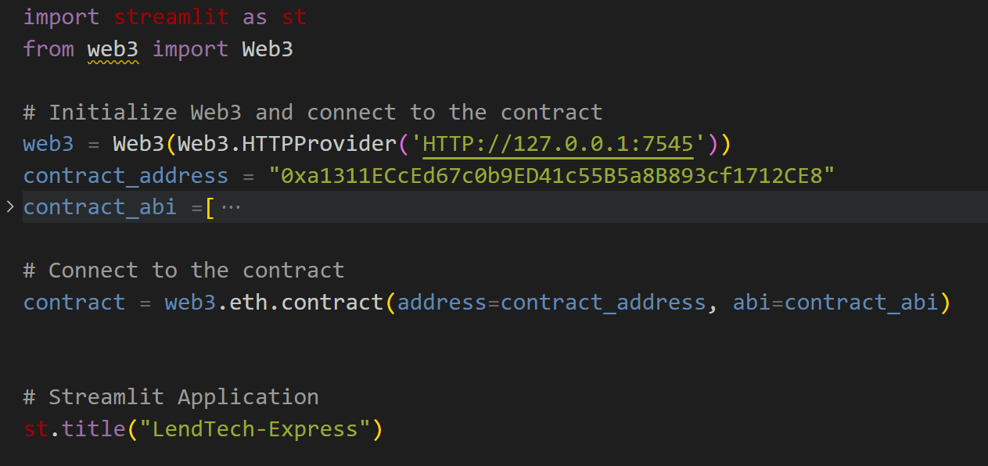
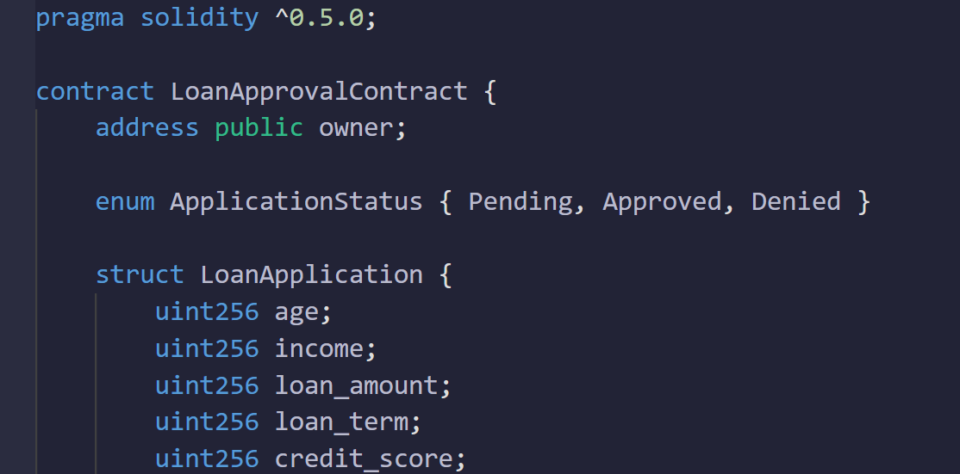
Streamlit Interface
Smart Contract Development
We used Python and Streamlit to create a user-friendly chatbot-based interface for loan applications, capturing essential applicant information.
In the REMIX IDE, we wrote a smart contract that evaluates loan applications based on predefined criteria and automatically approves or denies the application.

Slide 5
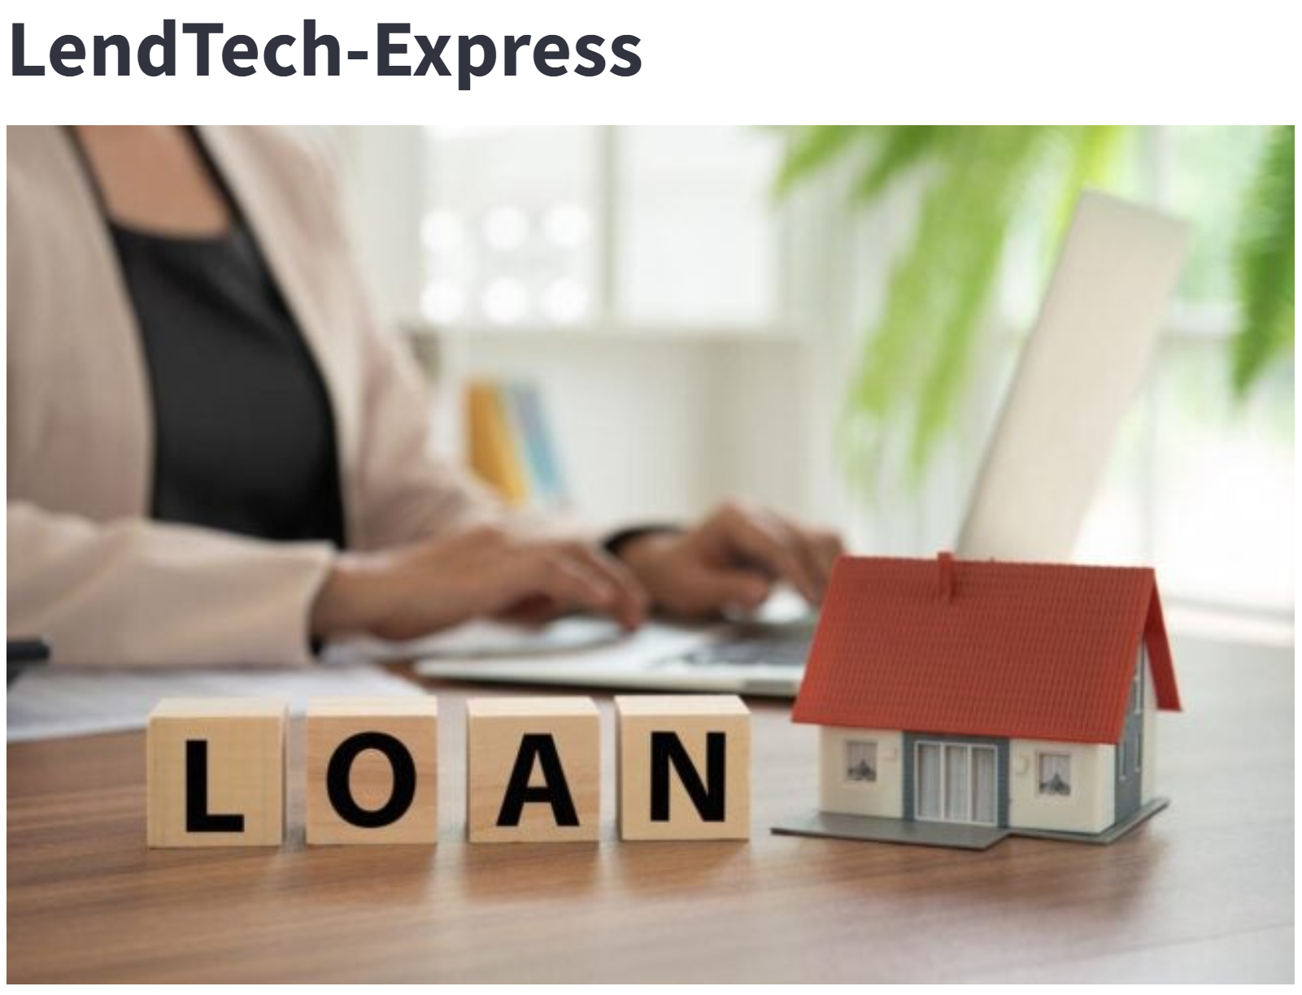
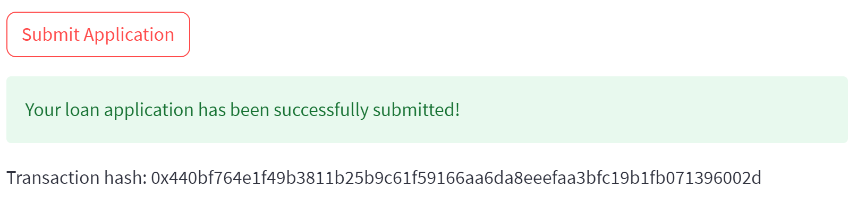
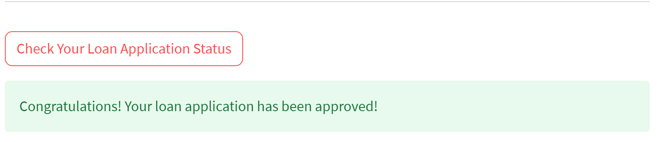
Smart Contract Development
evaluates loan applications and automatically approves or denies the application
Streamlit Interface
capturing essential applicant information

Slide 6

LendTech-Express
Demo
Ready Go

Slide 7

Insight
Challenge
Integrating smart contracts into financial applications enhances transparency and security.
Ensuring that the smart contract logic covers all relevant criteria for loan approval.
Results
Conclusions
The mortgage loan approval application successfully integrates Streamlit's intuitive UI with smart contracts for automated decision-making.
The project demonstrates how fintech can revolutionize traditional financial processes, making them more efficient and reliable.

Slide 8


Scalability
Adapt the application for handling a larger volume of loan applications simultaneously.
Machine Learning
Incorporate machine learning algorithms to enhance the accuracy of loan approval decisions.
Real Data Integration
Connect the application to real-world financial data for more robust testing.
Security Audit
Conduct a thorough security audit of the smart contract to identify vulnerabilities.
Next Steps

Slide 9

If granted additional time,
we would delve into:
Risk Assessment
30%
Developing a risk assessment model to evaluate the financial stability of applicants.
Regulatory Compliance
30%
Ensuring the smart contract aligns with relevant financial regulations.
User Experience Enhancement
40%
Continuously refining the Streamlit interface based on user feedback, include install payment calculations.

Slide 10

Thank you!
Vacation mode GO!

